Slide 1
Sampling
By
Dr. Temtim Assefa

Slide 2
Key concepts
Sampling frame/Population is the entire list of the population from which the sample is selected. Also called population
Sample is a portion of the population
Sample size is the number of units in a sample
Sampling unit is the constituents of a population which are individuals to be sampled from the population and cannot be further subdivided

Slide 3
Key concept …
Parameter is a characteristic of a population
Statistic is a characteristic of a sample.
These characteristics can be described using mean, median, mode and standard deviation
Sampling error is the discrepancy between a parameter and its estimate (or statistics) due to sampling process
Non-sampling errors are errors that occur during data collection

Slide 4
Sampling
It is a process of selecting a representative fraction of the large population
This is mainly because our research may budget, time and other constraints
Selecting all population may not be justifiable to reach on the same conclusion
We study by selecting a subset of the population
Sample must be true representative of the population

Slide 5
Type of Sampling
Probability sampling, and
Non probability sampling
Sampling

Slide 6
Probability Sampling
Each segment of the population will be represented in the sample
Selected by a process known as random selection
Each member of the population has an equal chance of being selected
Assume we have a beaker that contains 100ml of water and the other 10ml concentrated acid. After mixing the two, if extracted 1ml, from any part of the solution, and find that sample contains precisely 10 parts water and 1 part acid

Slide 7
Cont’d
The same is assumed to be true if the sample is selected from a population who have considerably variability in race, wealth, education, social standing, and other factors –
This is, however, practically impossible!

Slide 8
How Samples are selected
There are different methods
Assign each person in the population a different number and use an arbitrary method of picking certain numbers
Drawing numbers out of a hat
Using computer random number generator – application SW like Spreadsheet and Microsoft works has a random number generator module

Slide 9
Type of Random Samples
Simple random sampling
Stratified sampling
Cluster sampling
A combination of the above methods

Slide 10
Simple Random Sampling
The least sophisticated one
Applicable for small and all members of population is known
e.g if we study our organization software user satisfaction
Procedure:
number the units in the population from 1 to N
decide on the n (sample size) that you want to select
Use K = N/n formula to decide sample interval
where N total population ,
n is sample size
K is the sample interval
randomly select an integer between 1 to k
Then take every K^{th} unit
Not recommended for large and unknown population size

Slide 11
Example
Divide 100 by 20, you will get 5.
Randomly select any number between 1 and five.
Suppose the number you have picked is 4, that will be your starting number.
So student number 4 has been selected.
From there you will select every 5th name until you reach the last one, number one hundred. You will end up with 20 selected students.

Slide 12
Stratified Random Sampling
Also sometimes called proportional or quota random sampling,
Dividing population into homogeneous subgroups and then use simple random sample method to select samples from each subgroup.
Objective: Divide the population into non-overlapping groups (i.e., strata) N1, N2, N3, ... Ni, such that N1 + N2 + N3 + ... + Ni = N.
Then do a simple random sample of K = N/n from each strata.
If you study software development success. You expect groups like in-house developed, outsourced and off the shelf software.

Slide 13
cont’d …
We select the required sample from each of the strata
It guarantees equal representation of each strata
Good if each strata has equal population size
For example, if in house developed (20%), outsourced (50%) and off the shelf (30%), your sample should reflect this proportion

Slide 14
Advantage & Disadvantage
Advantage
focuses on important subpopulations but ignores irrelevant ones
improves the accuracy of estimation
efficient
sampling equal numbers from strata varying widely in size may be used to equate the statistical power of tests of differences between strata.
Disadvantage
can be difficult to select relevant stratification variables
not useful when there are no homogeneous subgroups
can be expensive
requires accurate information about the population, or introduces bias.

Slide 15
Cluster Sampling
When the population is spread out to a larger geographical area, it may not feasible to make up a list of every person living within the area and select a sample for the study using random procedures
Steps:
divide population into clusters (usually along geographic boundaries or type of institutions or other clustering criteria
Randomly select sampled clusters
Then take a list of population in the selected cluster and then apply simple random sampling method or other random selection method.

Slide 16
Cluster sampling
Section 1
Section 2
Section 3
Section 5
Section 4

Slide 17
Non Probability Sampling
The researcher has no way of forecasting or guaranteeing each member of the population has equal change of being selected in the sample
There are three types:
Convenience sampling
Quota sampling
Purposive sampling
Snowball sampling

Slide 18
Convenience sample
A is used when you simply stop anybody in the street who is prepared to stop, or when you wander round a business, a shop, a restaurant, a theatre or whatever, asking people you meet whether they will answer your questions.
In other words, the sample comprises subjects who are simply available in a convenient way to the researcher.
There is no randomness and the likelihood of bias is high.
can't draw any meaningful conclusions from the results you obtain.
However, this method is often the only feasible one, particularly for students or others with restricted time and resources, and can legitimately be used provided its limitations are clearly understood and stated.

Slide 19
Quota sampling
is often used in market research. Interviewers are required to find cases with particular characteristics.
They are given quota of particular types of people to interview and the quota are organized so that final sample should be representative of population.
Stages
Decide on characteristic of which sample is to be representative, e.g. age
Find out distribution of this variable in population and set quota accordingly.
E.g. if 20% of population is between 20 and 30, and sample is to be 1,000 then 200 of sample (20%) will be in this age group

Slide 20
A purposive sample
is one which is selected by the researcher subjectively.
The researcher attempts to obtain sample that appears to him/her to be representative of the population and will usually try to ensure that a range from one extreme to the other is included.
Often used in political polling - districts chosen because their pattern has in the past provided good idea of outcomes for whole electorate.

Slide 21
Snowball sampling
With this approach, you initially contact a few potential respondents and then ask them whether they know of anybody with the same characteristics that you are looking for the next sample selection
this method is good if you do not know your respondents.
It may have also a danger not to access respondents with a different views from those respondents you have already contacted

Slide 22
Determining sample size
Determination of sample size depends on the following factors:
Type of design
Accessibility of participants
Statistical tests planned
Review of the literature – other similar studies
Cost (time and money)

Slide 23
Sample Size Calculations
Before you calculate a sample size, you need to determine a few things about the target population and the sample you need:
Population Size —
How many total people fit your population?
For instance, if you want to know computers in Ethiopia, your population size would be the total number of computers in Ethiopia Don’t worry if you are unsure about this number. It is common for the population to be unknown or approximated.
Margin of Error (Confidence Interval) —
No sample will be perfect, so you need to decide how much error to allow.
The confidence interval determines how much higher or lower than the population mean you are willing to let your sample mean fall.
It will look something like this: “60% of computers are DELL, with a margin of error of +/- 5%.”

Slide 24
Margin of Error
We are interested to study users willingness for e-learning based training. There are 200 respondents. From these respondents, 150 respondents say that e-learning based training is good. Our margin of error is 3%.
3/100 X 150 = 4.5
Therefore, we select many samples, respondents who say e-learning based training cannot be outside 145.5 to 154.5.

Slide 25
Formula method …
Our decisions should be like..
We need a margin of error less than 2.5%".
Typical surveys have margins of error ranging from less than 1% to something of the order of 4% . we can choose any margin of error we like but need to specify it.
95% confidence intervals are typical but not in any way mandatory. We could do 90%, 99% or something else entirely. For this example, we assume 95%.
May be guided by past surveys or general knowledge of public opinion.
For example a study made by other research found that there are 20% internet users. This gives p estimate

Slide 26
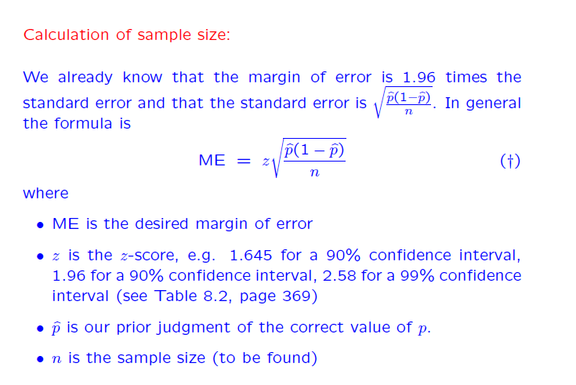
Determining sample size - Formula
95%

Slide 27
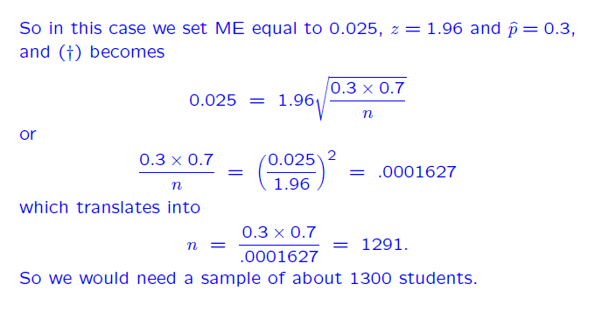
Formula Method ….

Slide 28
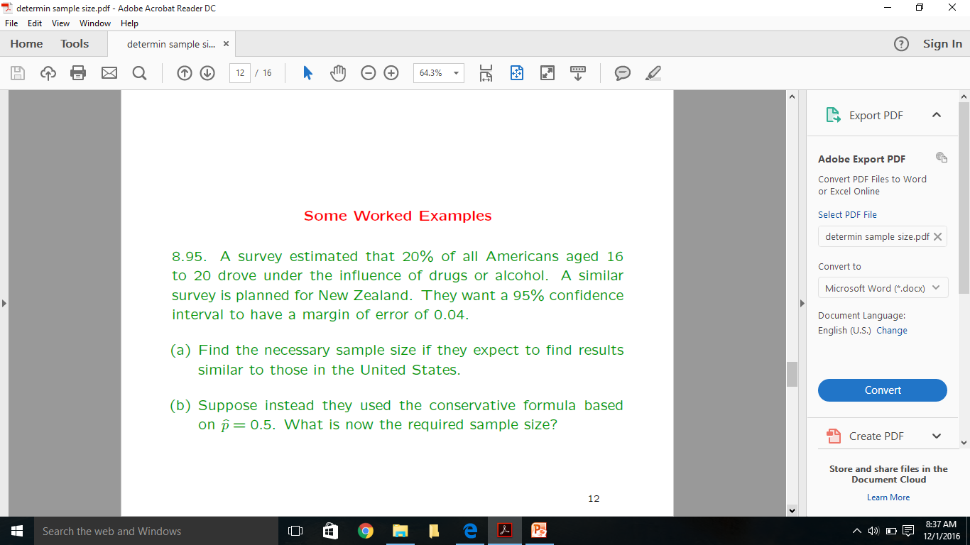
Formula method …

Slide 29
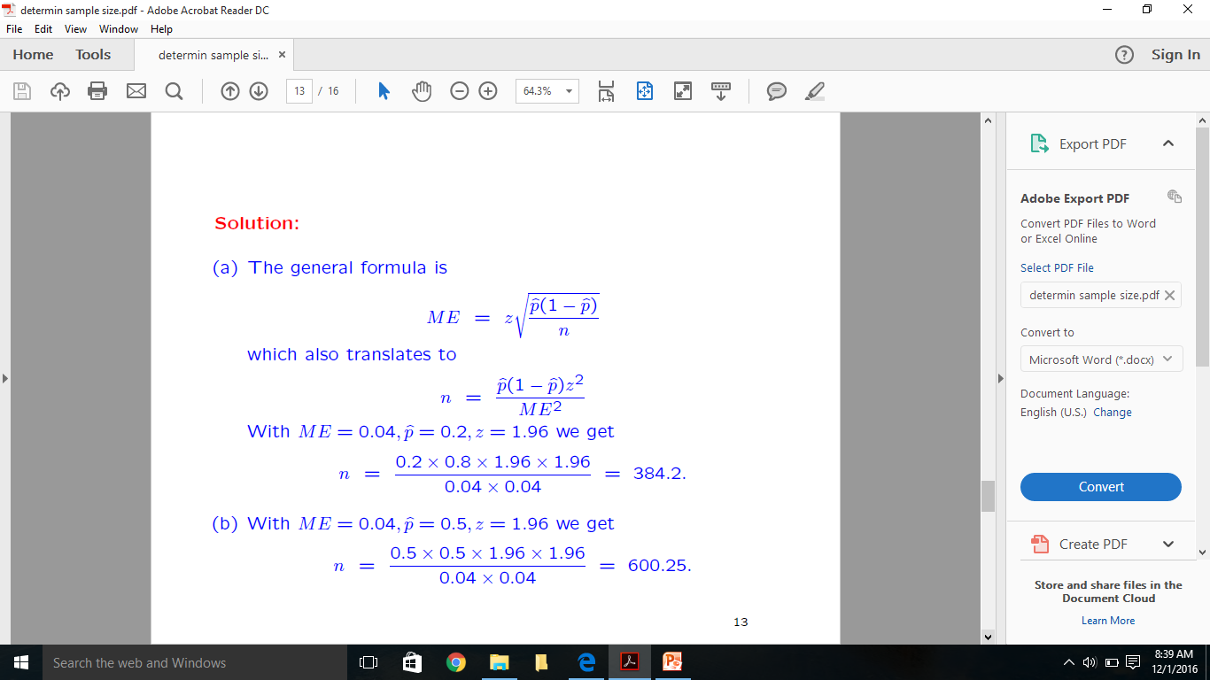
Solution to the example

Slide 30
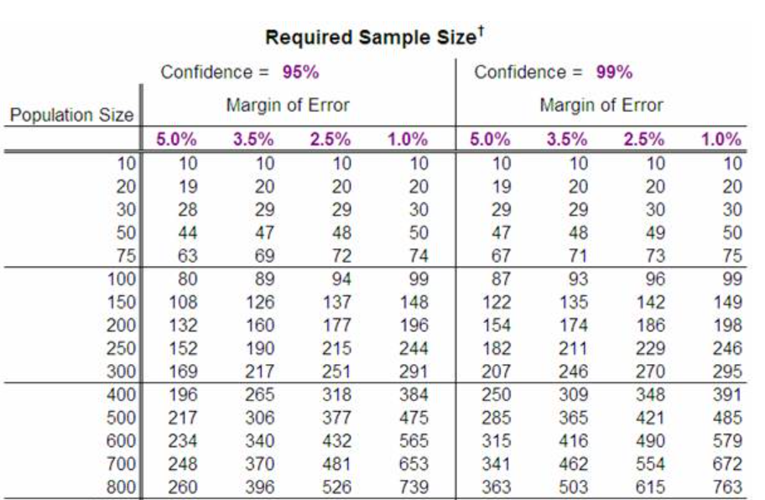
Table Method – Simple Method

Slide 31
How to control sampling error?
Use random selection of subjects
Use random assignment of subjects to groups
Estimate required sample size using power analysis to ensure adequate power
Overestimate required sample size to account for sample mortality (drop out)

Slide 32
Effect Size
Effect size can be thought of as how big a difference the intervention made.
When the effect size is
Small (correlations around 0.20)
Requires larger sample size
Medium (correlations around 0.40)
Requires medium sample size
Large (correlations around 0.60)
Requires smaller sample size

Slide 33
Eta Squared (ŋ²)
In ANOVA, it is the proportion of dependent variable (Y) explained by the independent variable.
Estimate of Effect Size
Similar to R² in multiple regression analysis.

Slide 34
Review Questions
What is sampling?
Why we undertake sampling?
What are the different methods of sampling?
What is the advantage of probability sampling from non probability sampling?
How do you decide your sample size?
How do you control the sample error?

